Slide 1
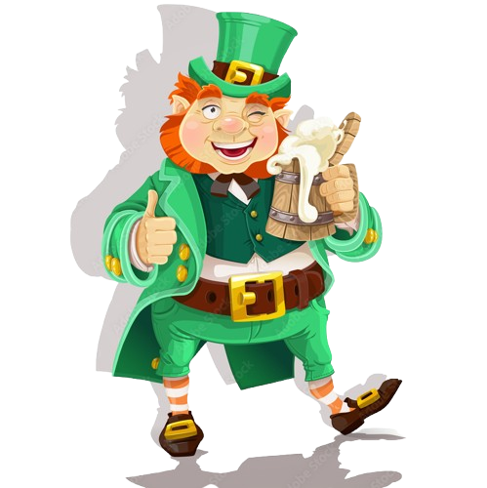
Drama Club Meeting
03/14/25

Slide 2
Attendance!
Guess how many gold coins are in the jar!

Slide 3
Clubapalooza
✿ Thank you for helping us make ~$100 !

Slide 4
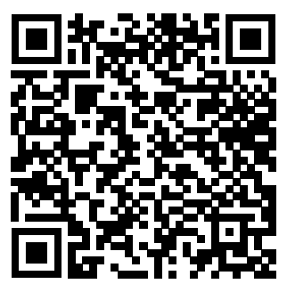
Thespians
Past Years Thespians Points Form

Slide 5
Website Updates
The website is in the process of being updated!!
✿ Testimonials still needed!!
❀ Tech (3), Cappies (3)
✿ DUE DATE: MARCH 17th!!

Slide 6
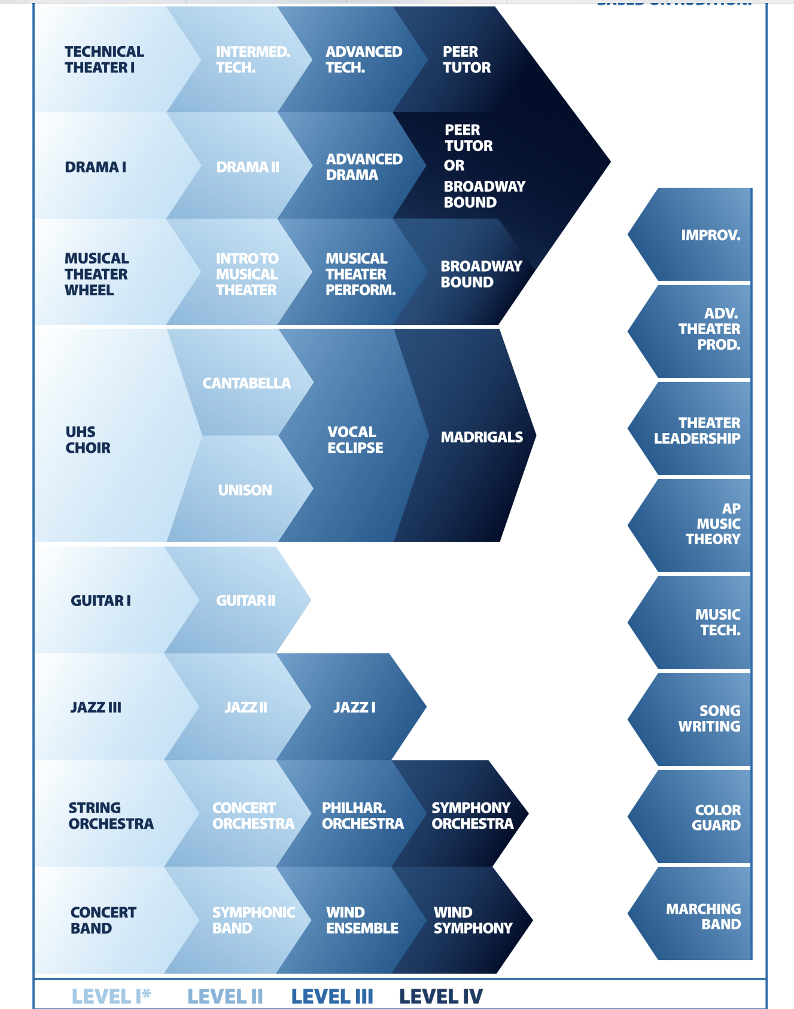
Next Year’s Enrollment

Slide 7
Leprechaun Game
Irish Jig

Slide 8
FAMILY NIGHT 3/19
✿ Find our booth at family night!
Feel free to talk to families about your personal experience with UTA and help exec draw attention to the booth!

Slide 9
CSz Sportz: Spring Match
March 21st, 6:30 PM in the Big Theater!

Slide 10
Deaf Arts Jubilee
Uni will be hosting DHH students from across Orange County for an Art Festival showcasing art from deaf artists. If you would like to attend, it’s Saturday, April 12th! :)

Slide 11
Local Theatre!
Hadestown @ Sage Hill
✿ 4/24/2025 7:00 PM 4/24/2025 9:00 PM
Into the Woods @ MTW
✿ Mar 28 - April 13
Hadestown @ Tesoro
✿ Wednesday, April 23, 7pm
✿ Thursday, April 24, 8pm
✿ Friday, April 25, 7pm
✿ Saturday, April 26, 1pm & 6pm

Slide 12
Guys & Dolls Video
Video Link

Slide 13
Career Fair
✿ Speak with Employers, College, and University Representatives
✿ Interactive
✿ Offering a platform for job seekers to network, learn about job opportunities, and potentially land a job or internship

Slide 14
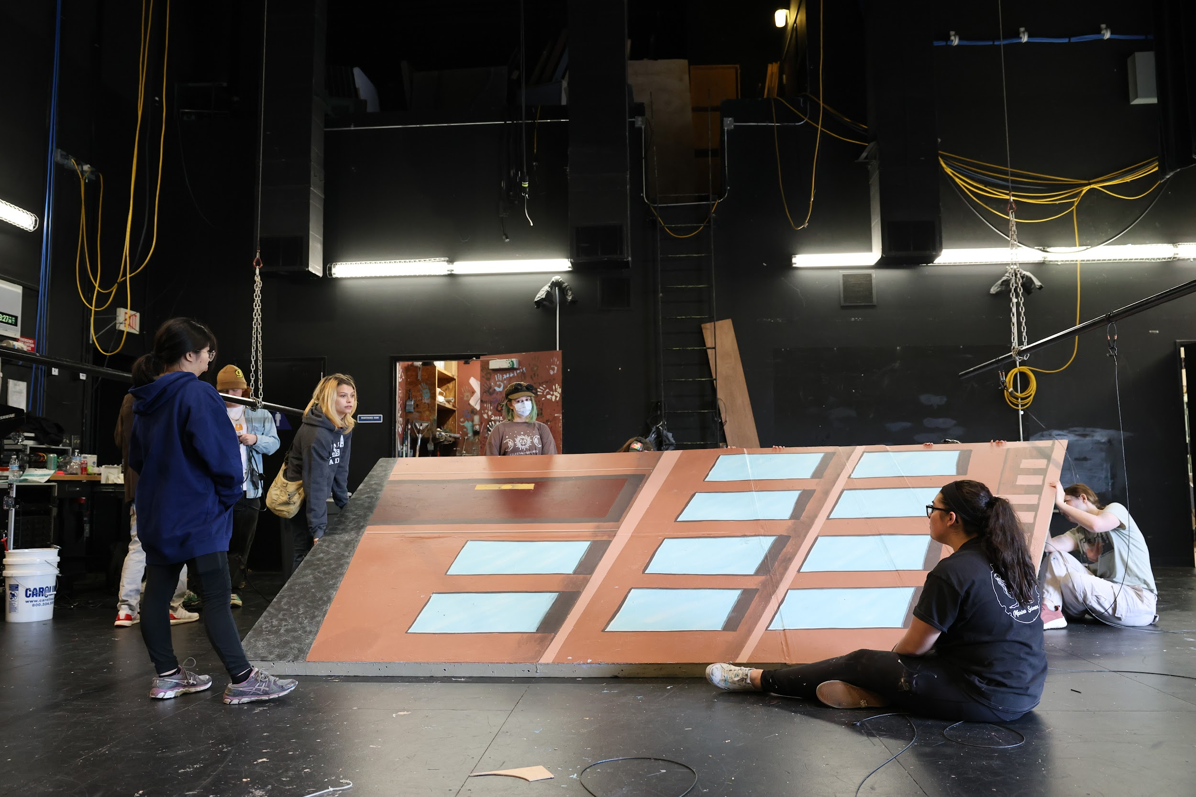
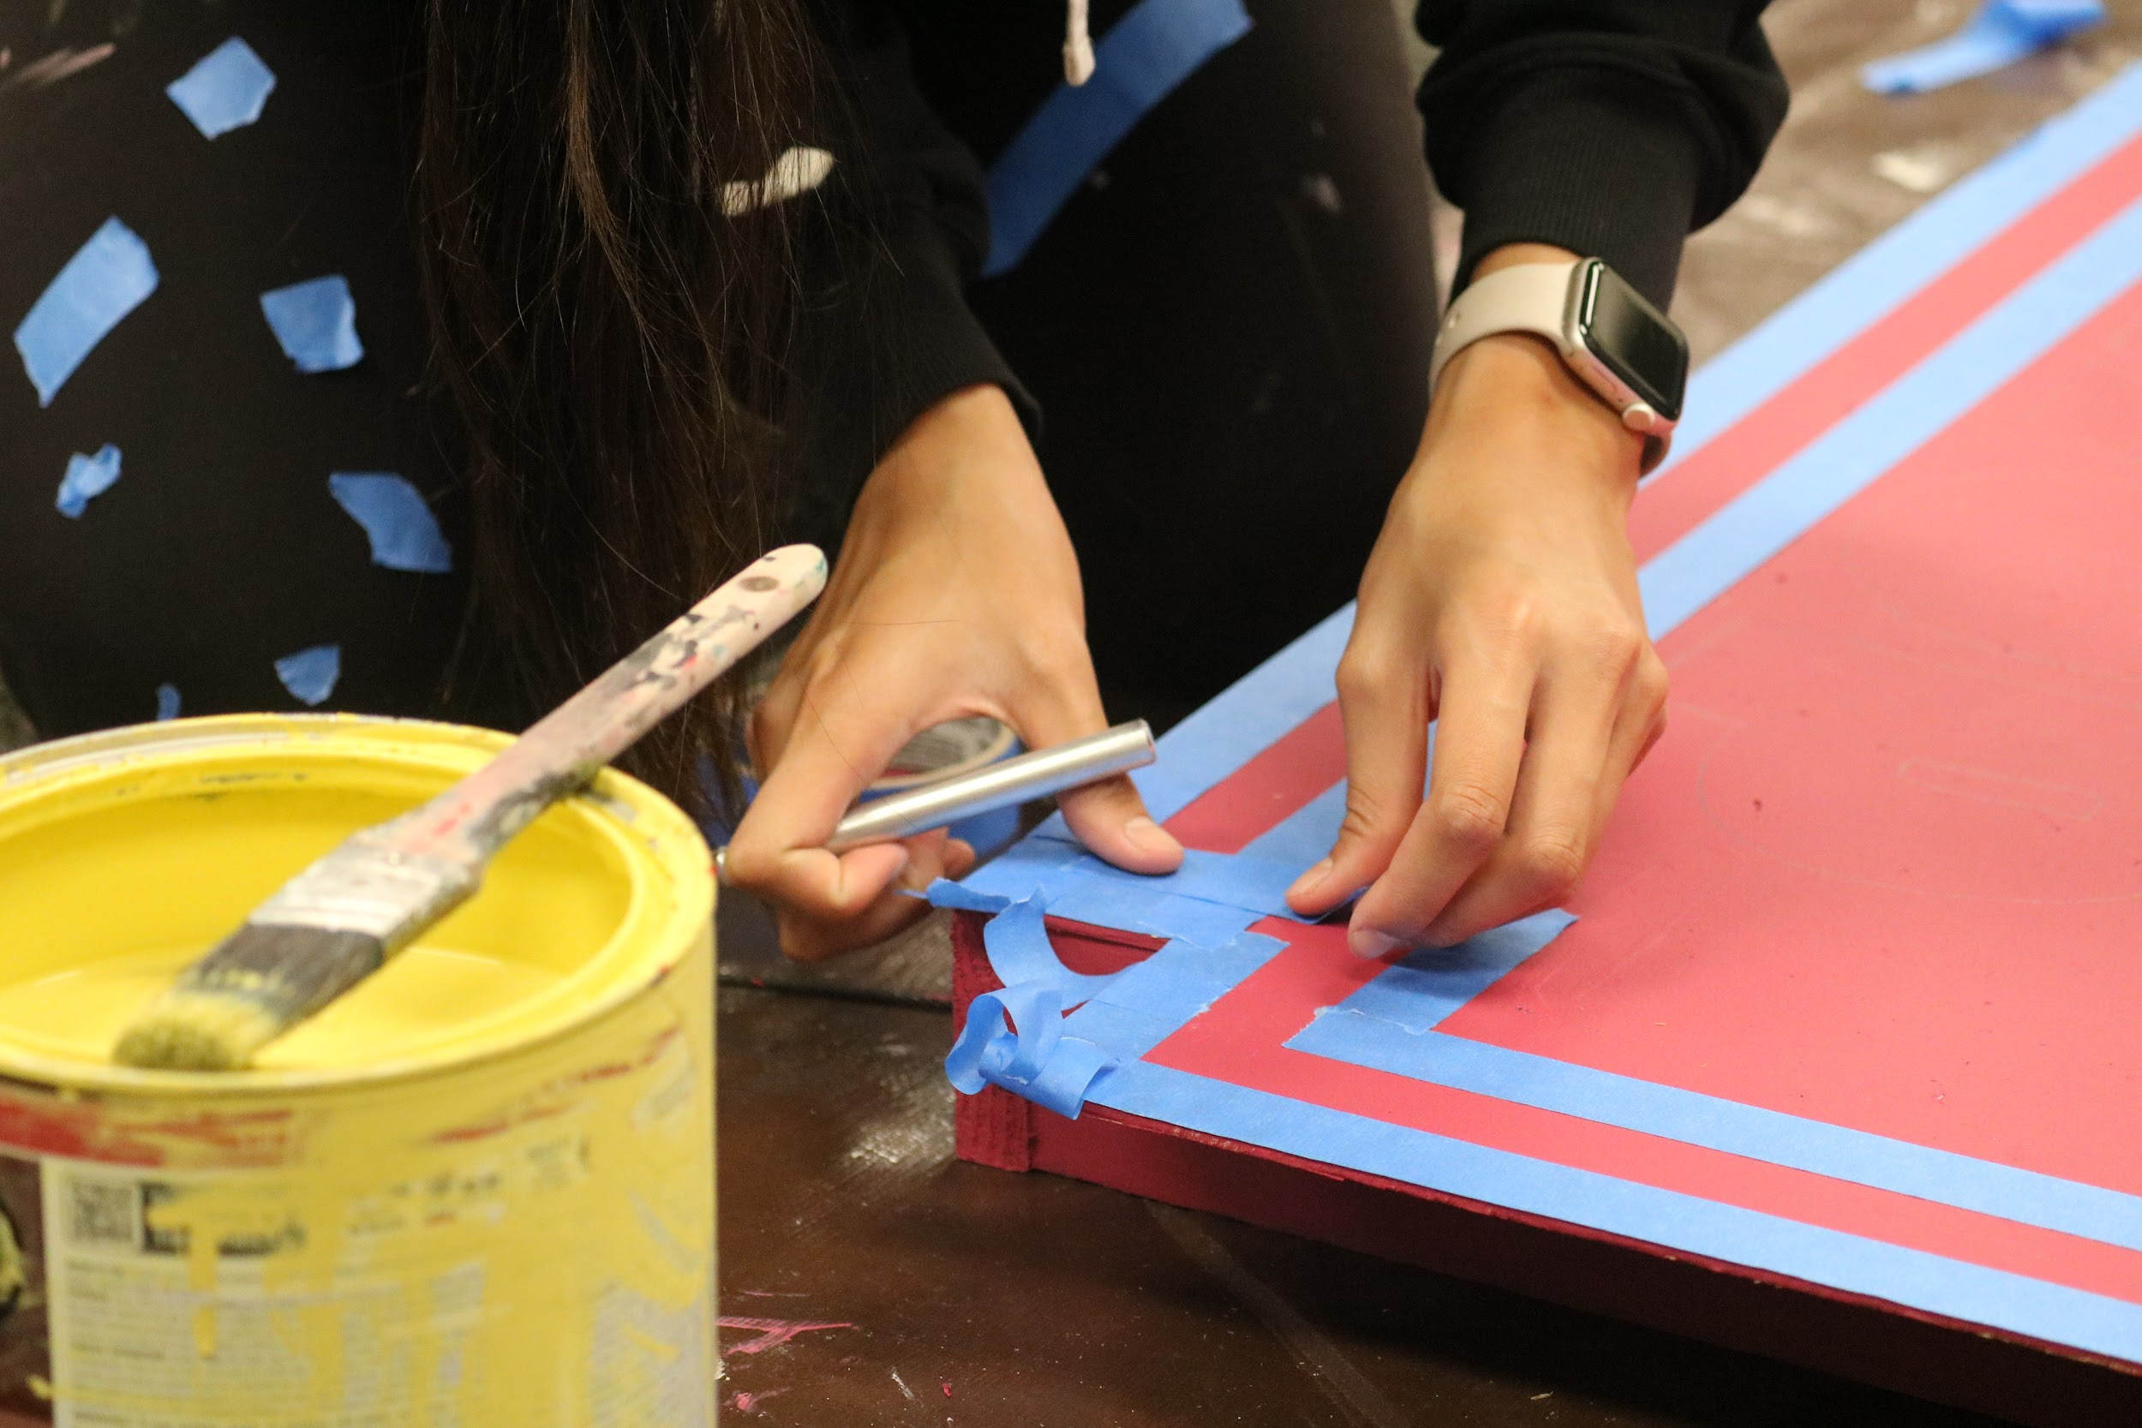
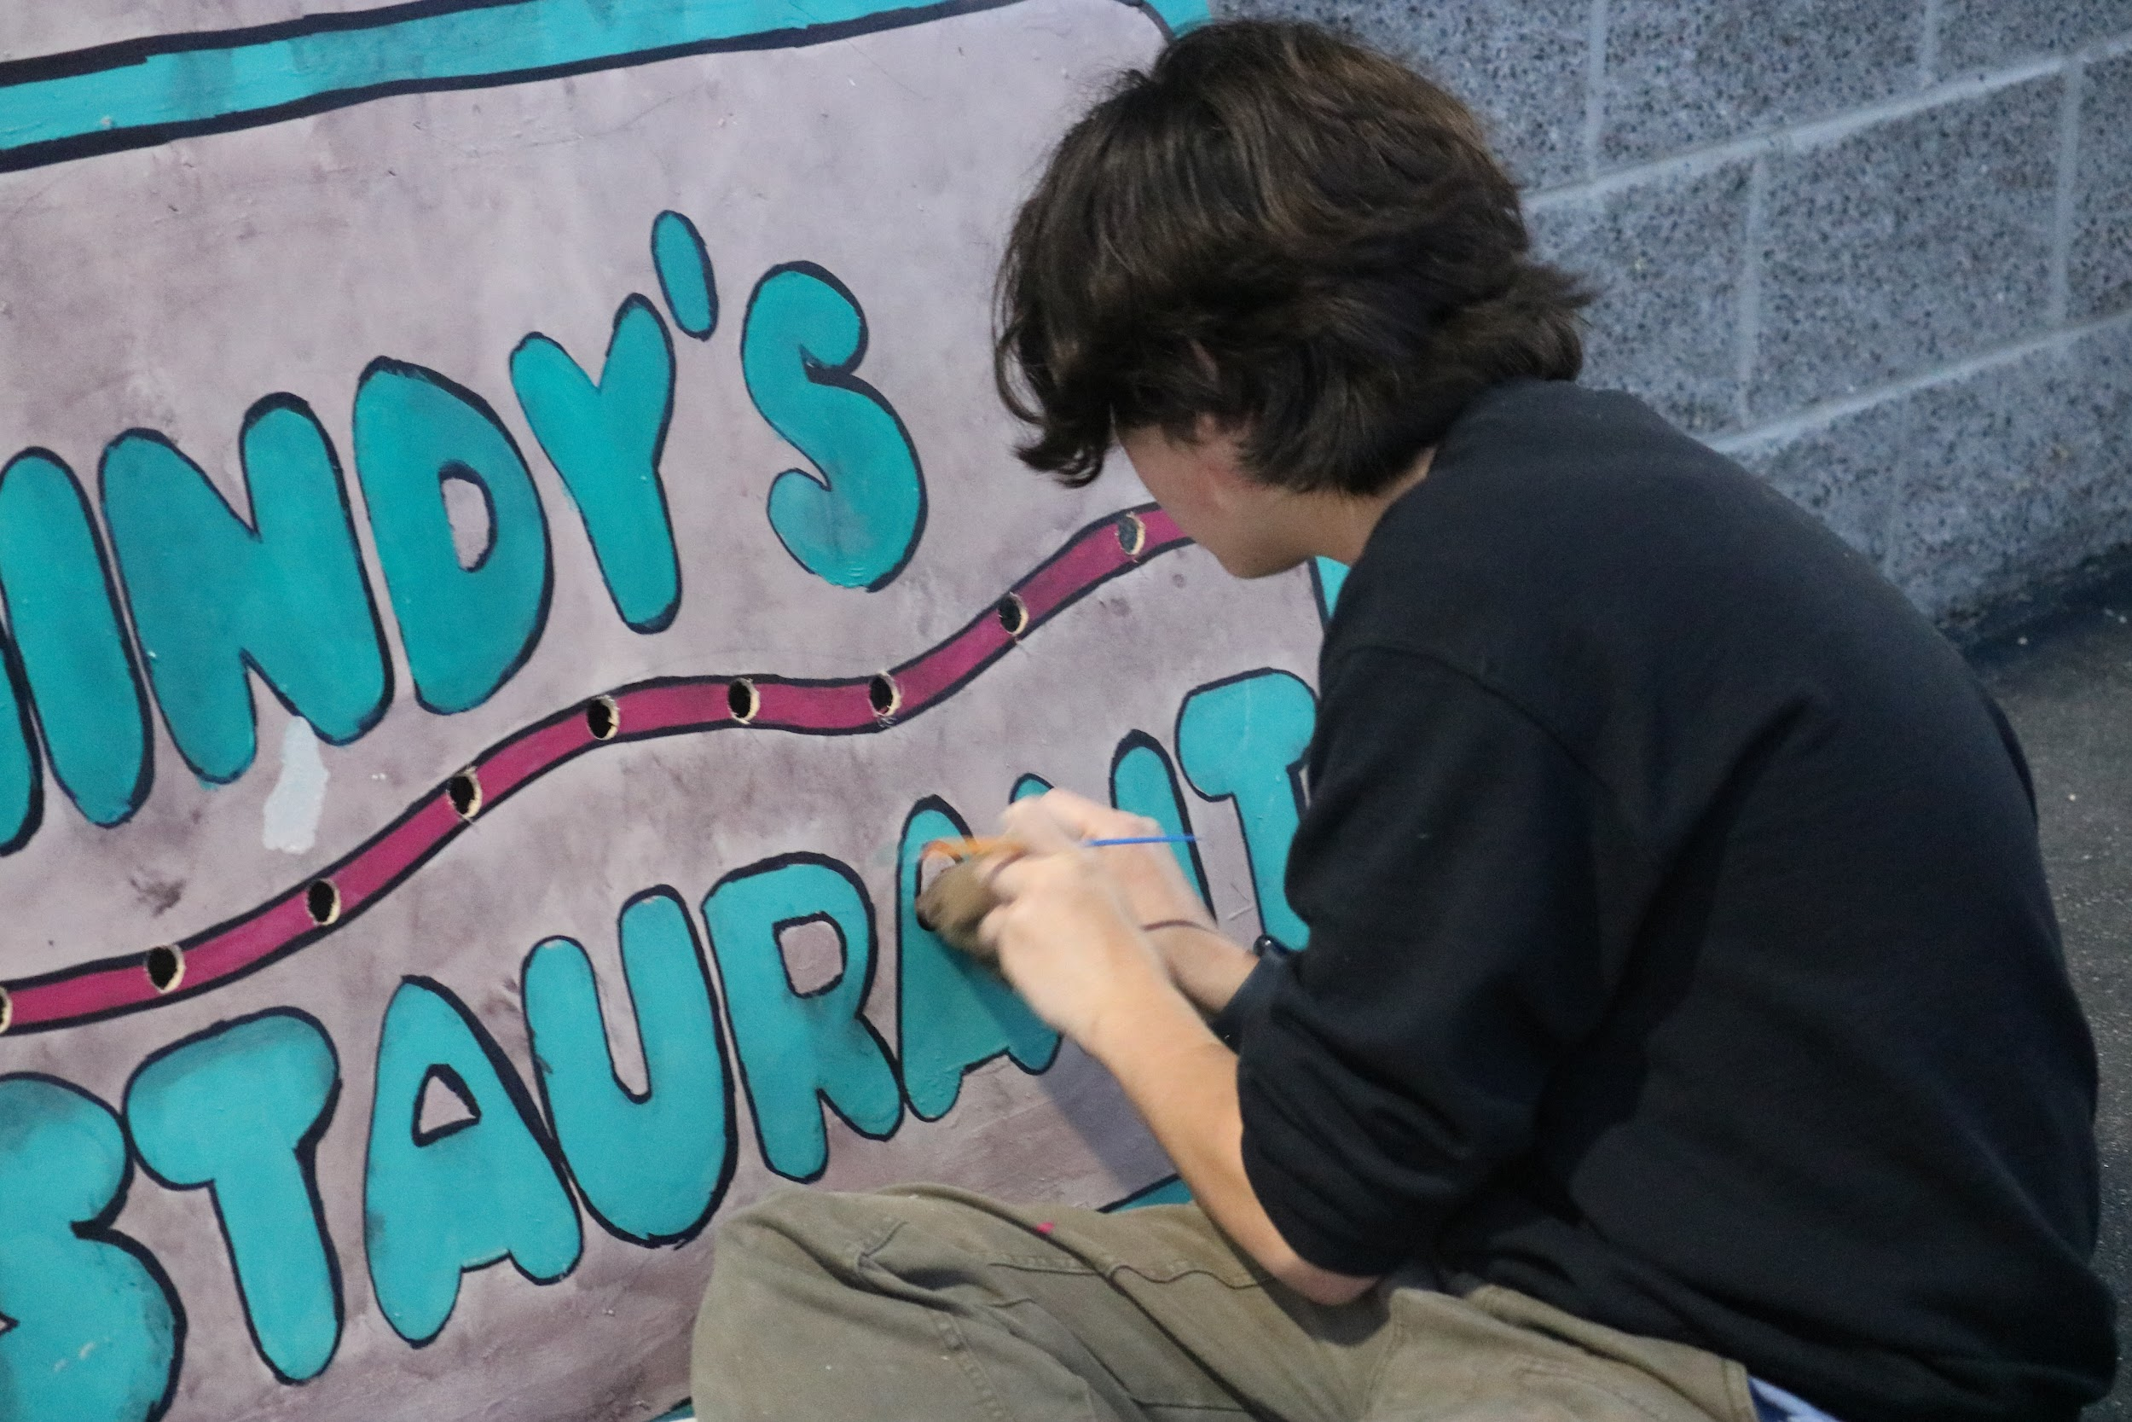
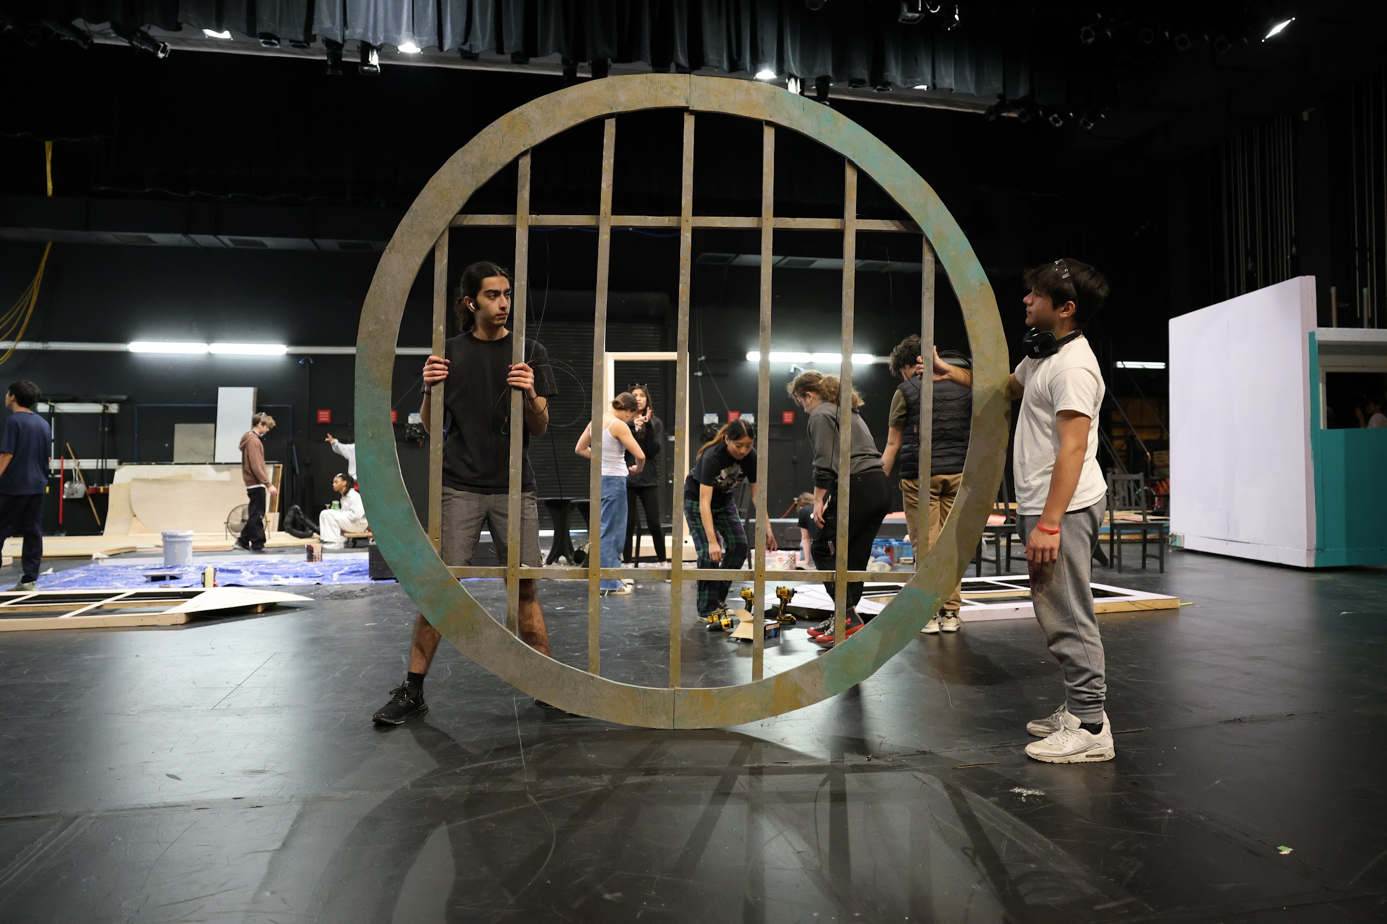
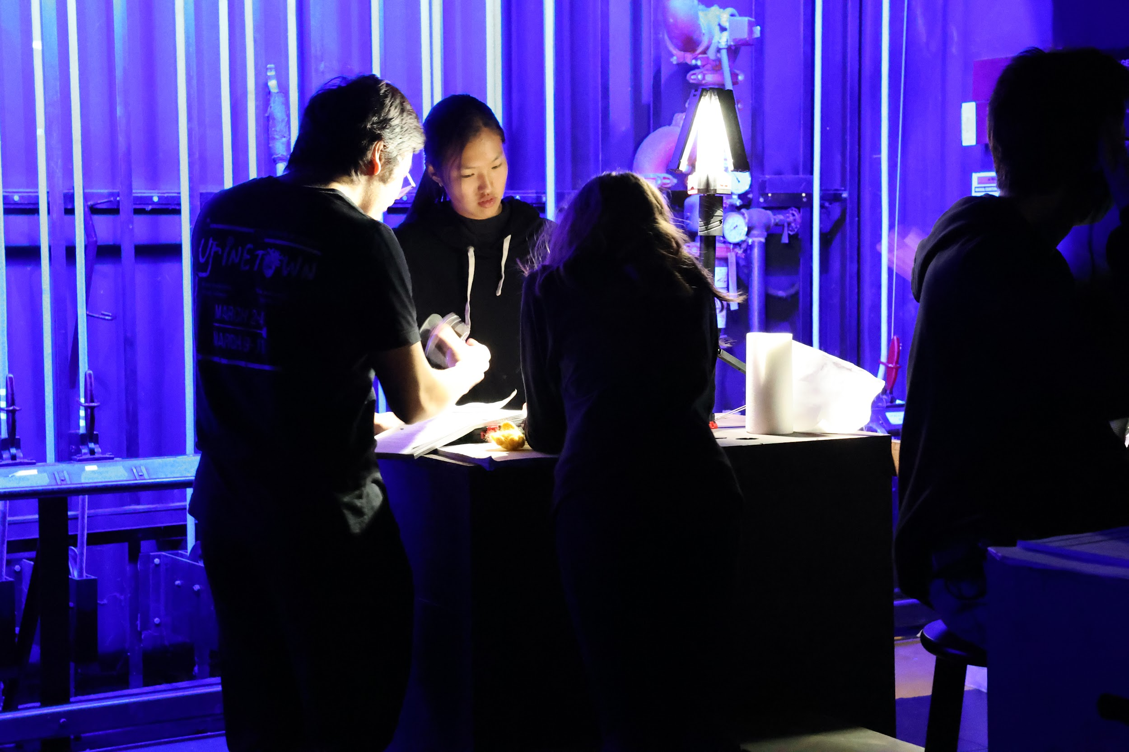
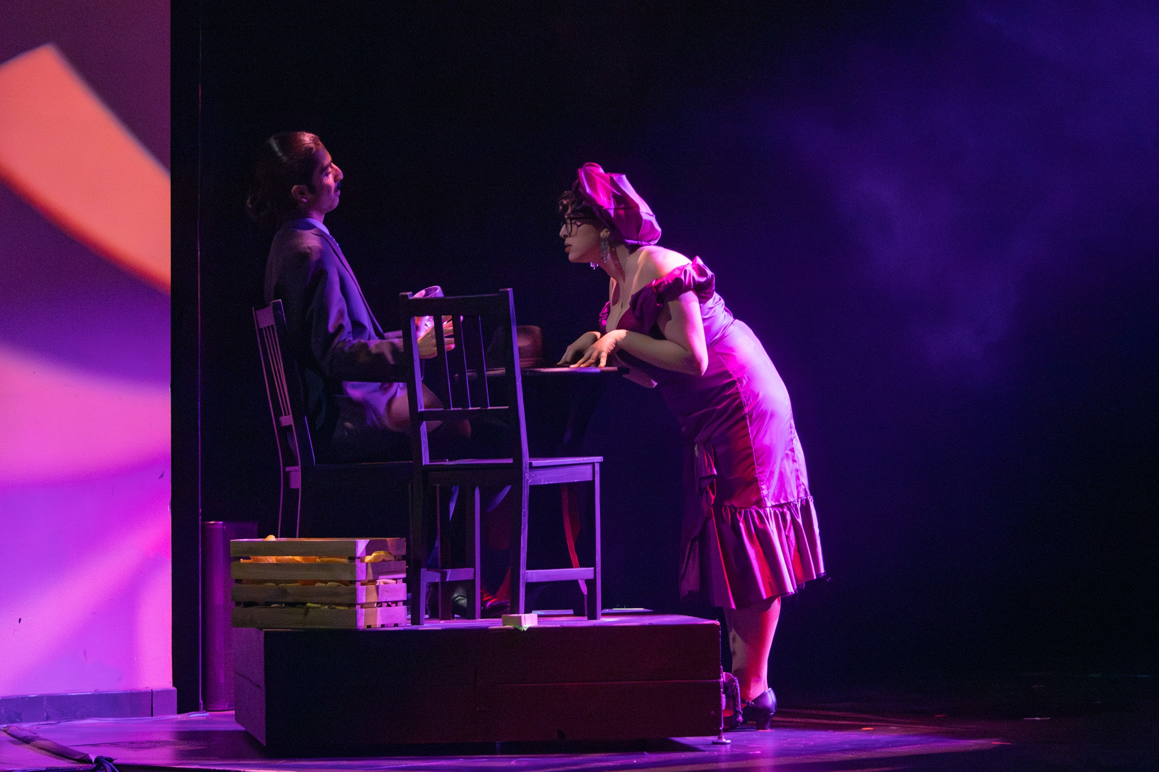
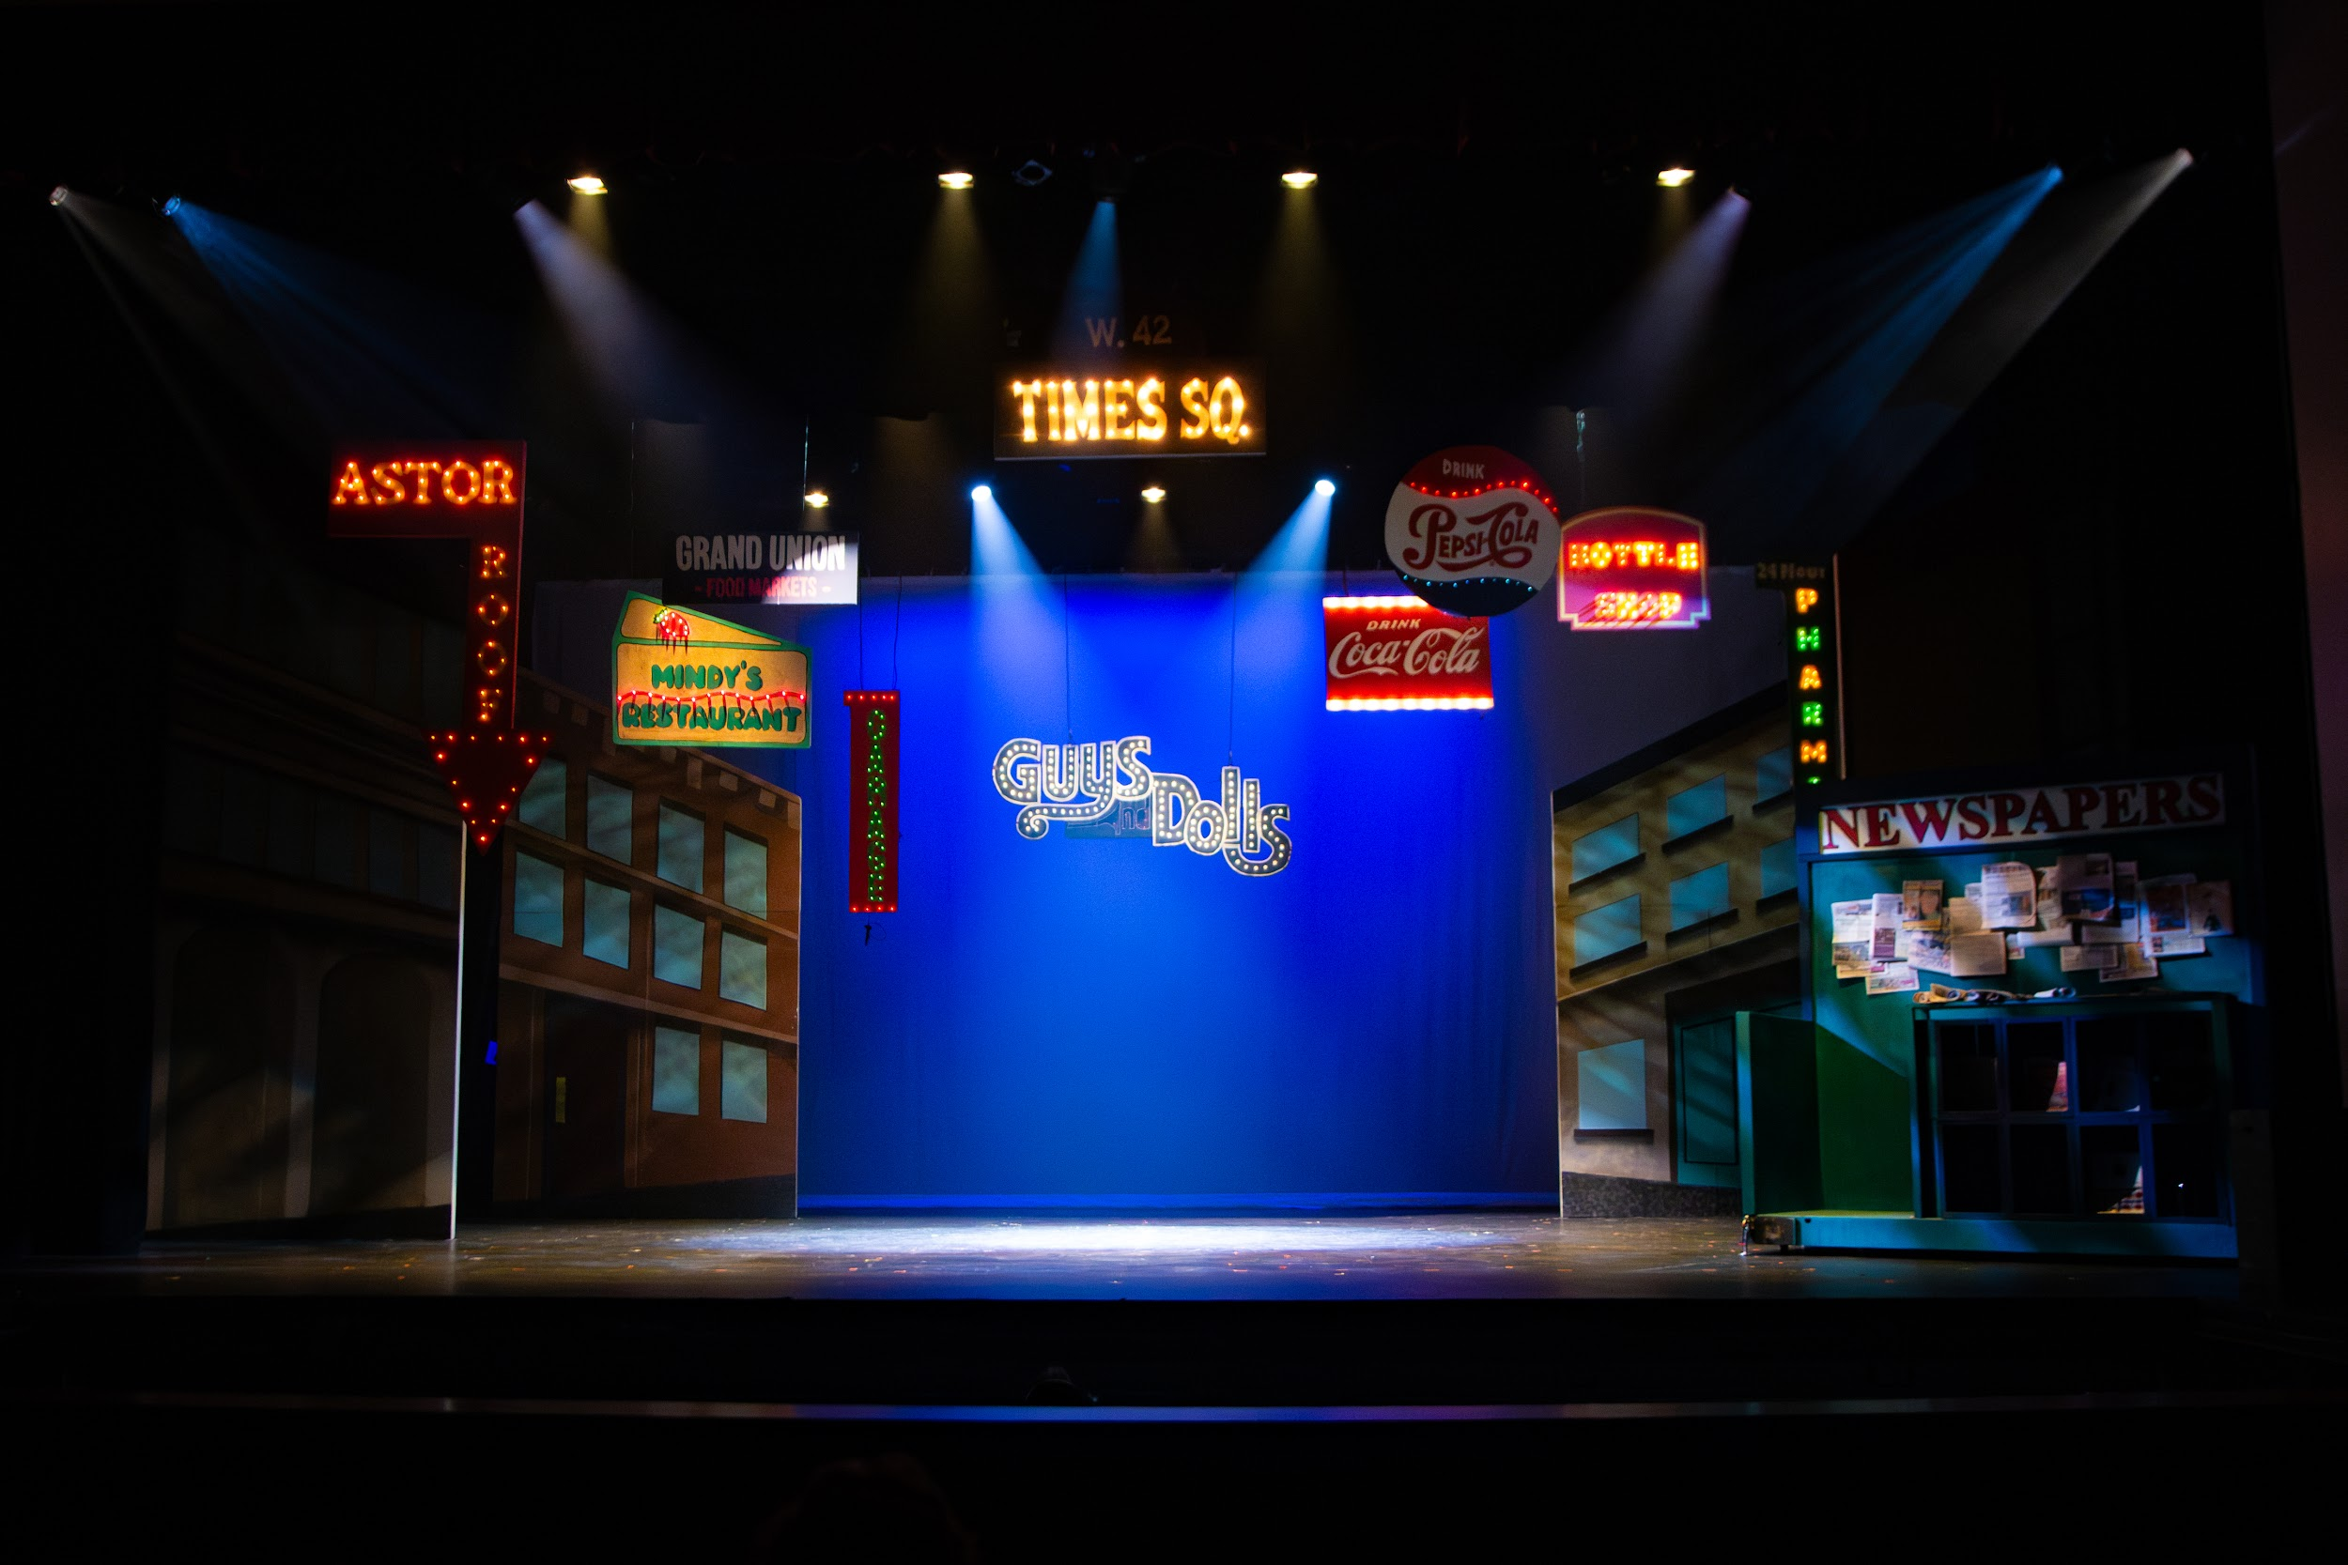
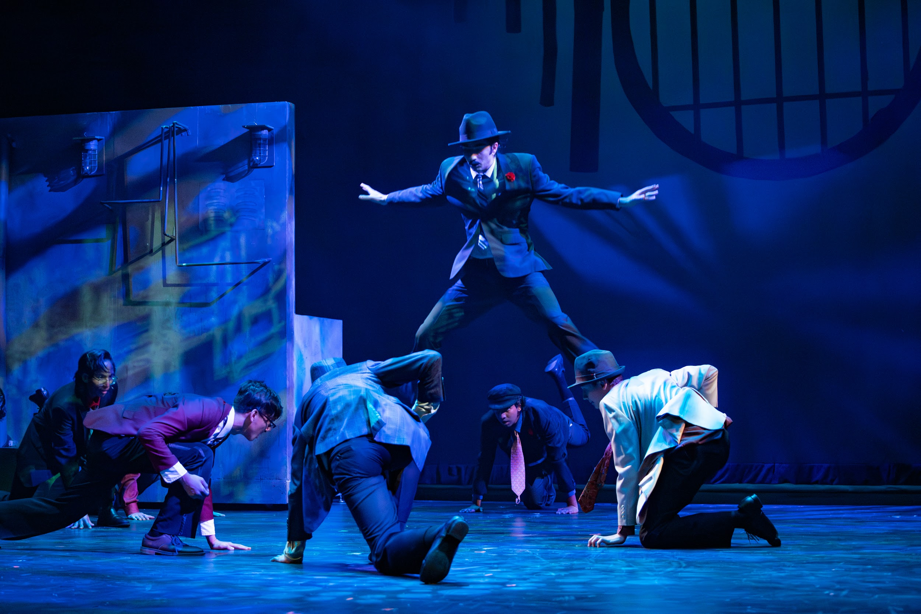
Guys & Dolls

Slide 15
unitheatrearts.org
Thank you!
Any videos or pictures? DM @ceuniaa on Instagram!

